Slide 1
Certificates, Public Key Infrastructures, and SSL/TLS
for infrastructure builders and operators
David Ochel, August 2019
2019-08-31-00
Unless otherwise noted, clip art is from pixabay.com and subject to PixaBay’s license (https://pixabay.com/service/terms/#license).
All remaining content that has not otherwise been attributed is released into the public domain under the CC0 1.0 – https://creativecommons.org/publicdomain/zero/1.0/.

Slide 2
Agenda & Outline
Objective: Align on the practical and security implications of managing infrastructure components that rely on TLS and (server) certificates for enabling transport security.
Applied crypto basics – 20’
Symmetric & asymmetric encryption
Hashes and digital signatures
What makes crypto hard
Public Key Infrastructures – 40’
Certificates & CAs – and how they are used in TLS
Lifecycle considerations for server keys and certificates
SSL/TLS – Configuration Gotchas – 30‘

Slide 3



Thwarting the “Man in the Middle”
Communication over (public) networks is not confidential, by design
Emails, web traffic, secrets, etc. can be intercepted and/or manipulated
Originators of content can be impersonated
Unless it is protected and authenticated, typically using encryption
TLS (as in, HTTPS, FTPS)
IPsec, OpenVPN, MACsec, … (or application-specific, like PGP and SSH)
PLAIN TEXT
PLAIN TEXTt
PLAIN TEXT
Notes:
https://pixabay.com/vectors/robber-burglar-bandit-stripes-303444/

Slide 4
Crypto basics
(because it’s the foundation for everything)

Slide 5

Secret Key – Symmetric Encryption
the key
01101001 11100011 10001111 10010101 10110100 00000110 11010100 10010011 11001111 10110000 00001010 11110000 10100011 00100001 10001011 01001111
One key, multiple copies
Good: fast, straightforward
Bad: key distribution (requires out-of-band, can’t control copies)
Examples: AES, Blowfish – e.g., 256 bit key length
(it’s actually a random string of bits)
PLAIN TEXT
PLAIN TEXT
CIPHER TEXT

Slide 6
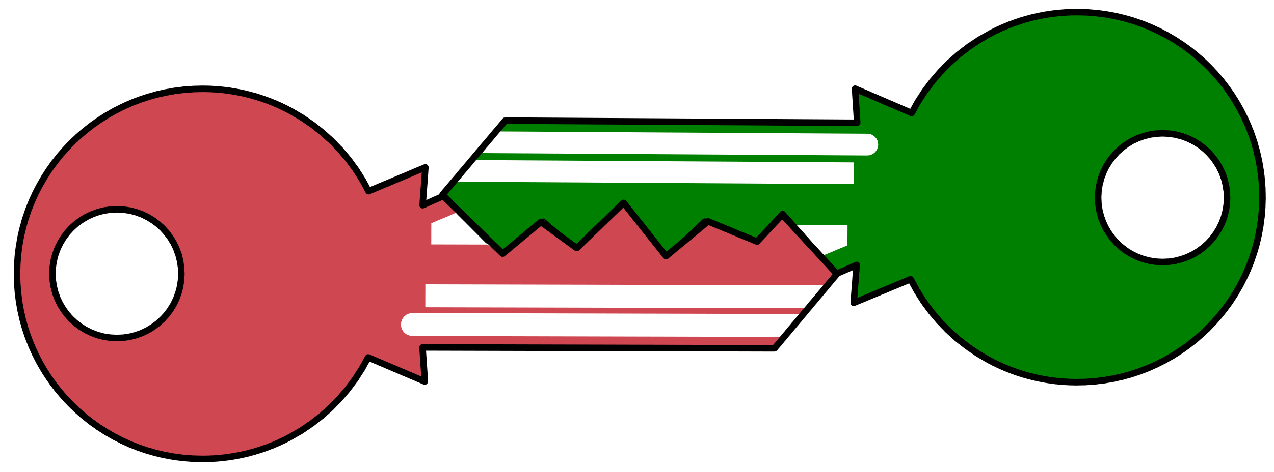


Public and private keys – Asymmetric Encryption
public key
private key
Mutually complementary pair of keys
Good: distribution (private key stays with owner, copies of the matching public key can be distributed freely); digital signatures
Bad: high CPU need, based on (theoretically solvable) math problems
Examples: RSA, Diffie Hellman – e.g., 2048 bit key length
PLAIN TEXT
CIPHER TEXT
PLAIN TEXT

Slide 7
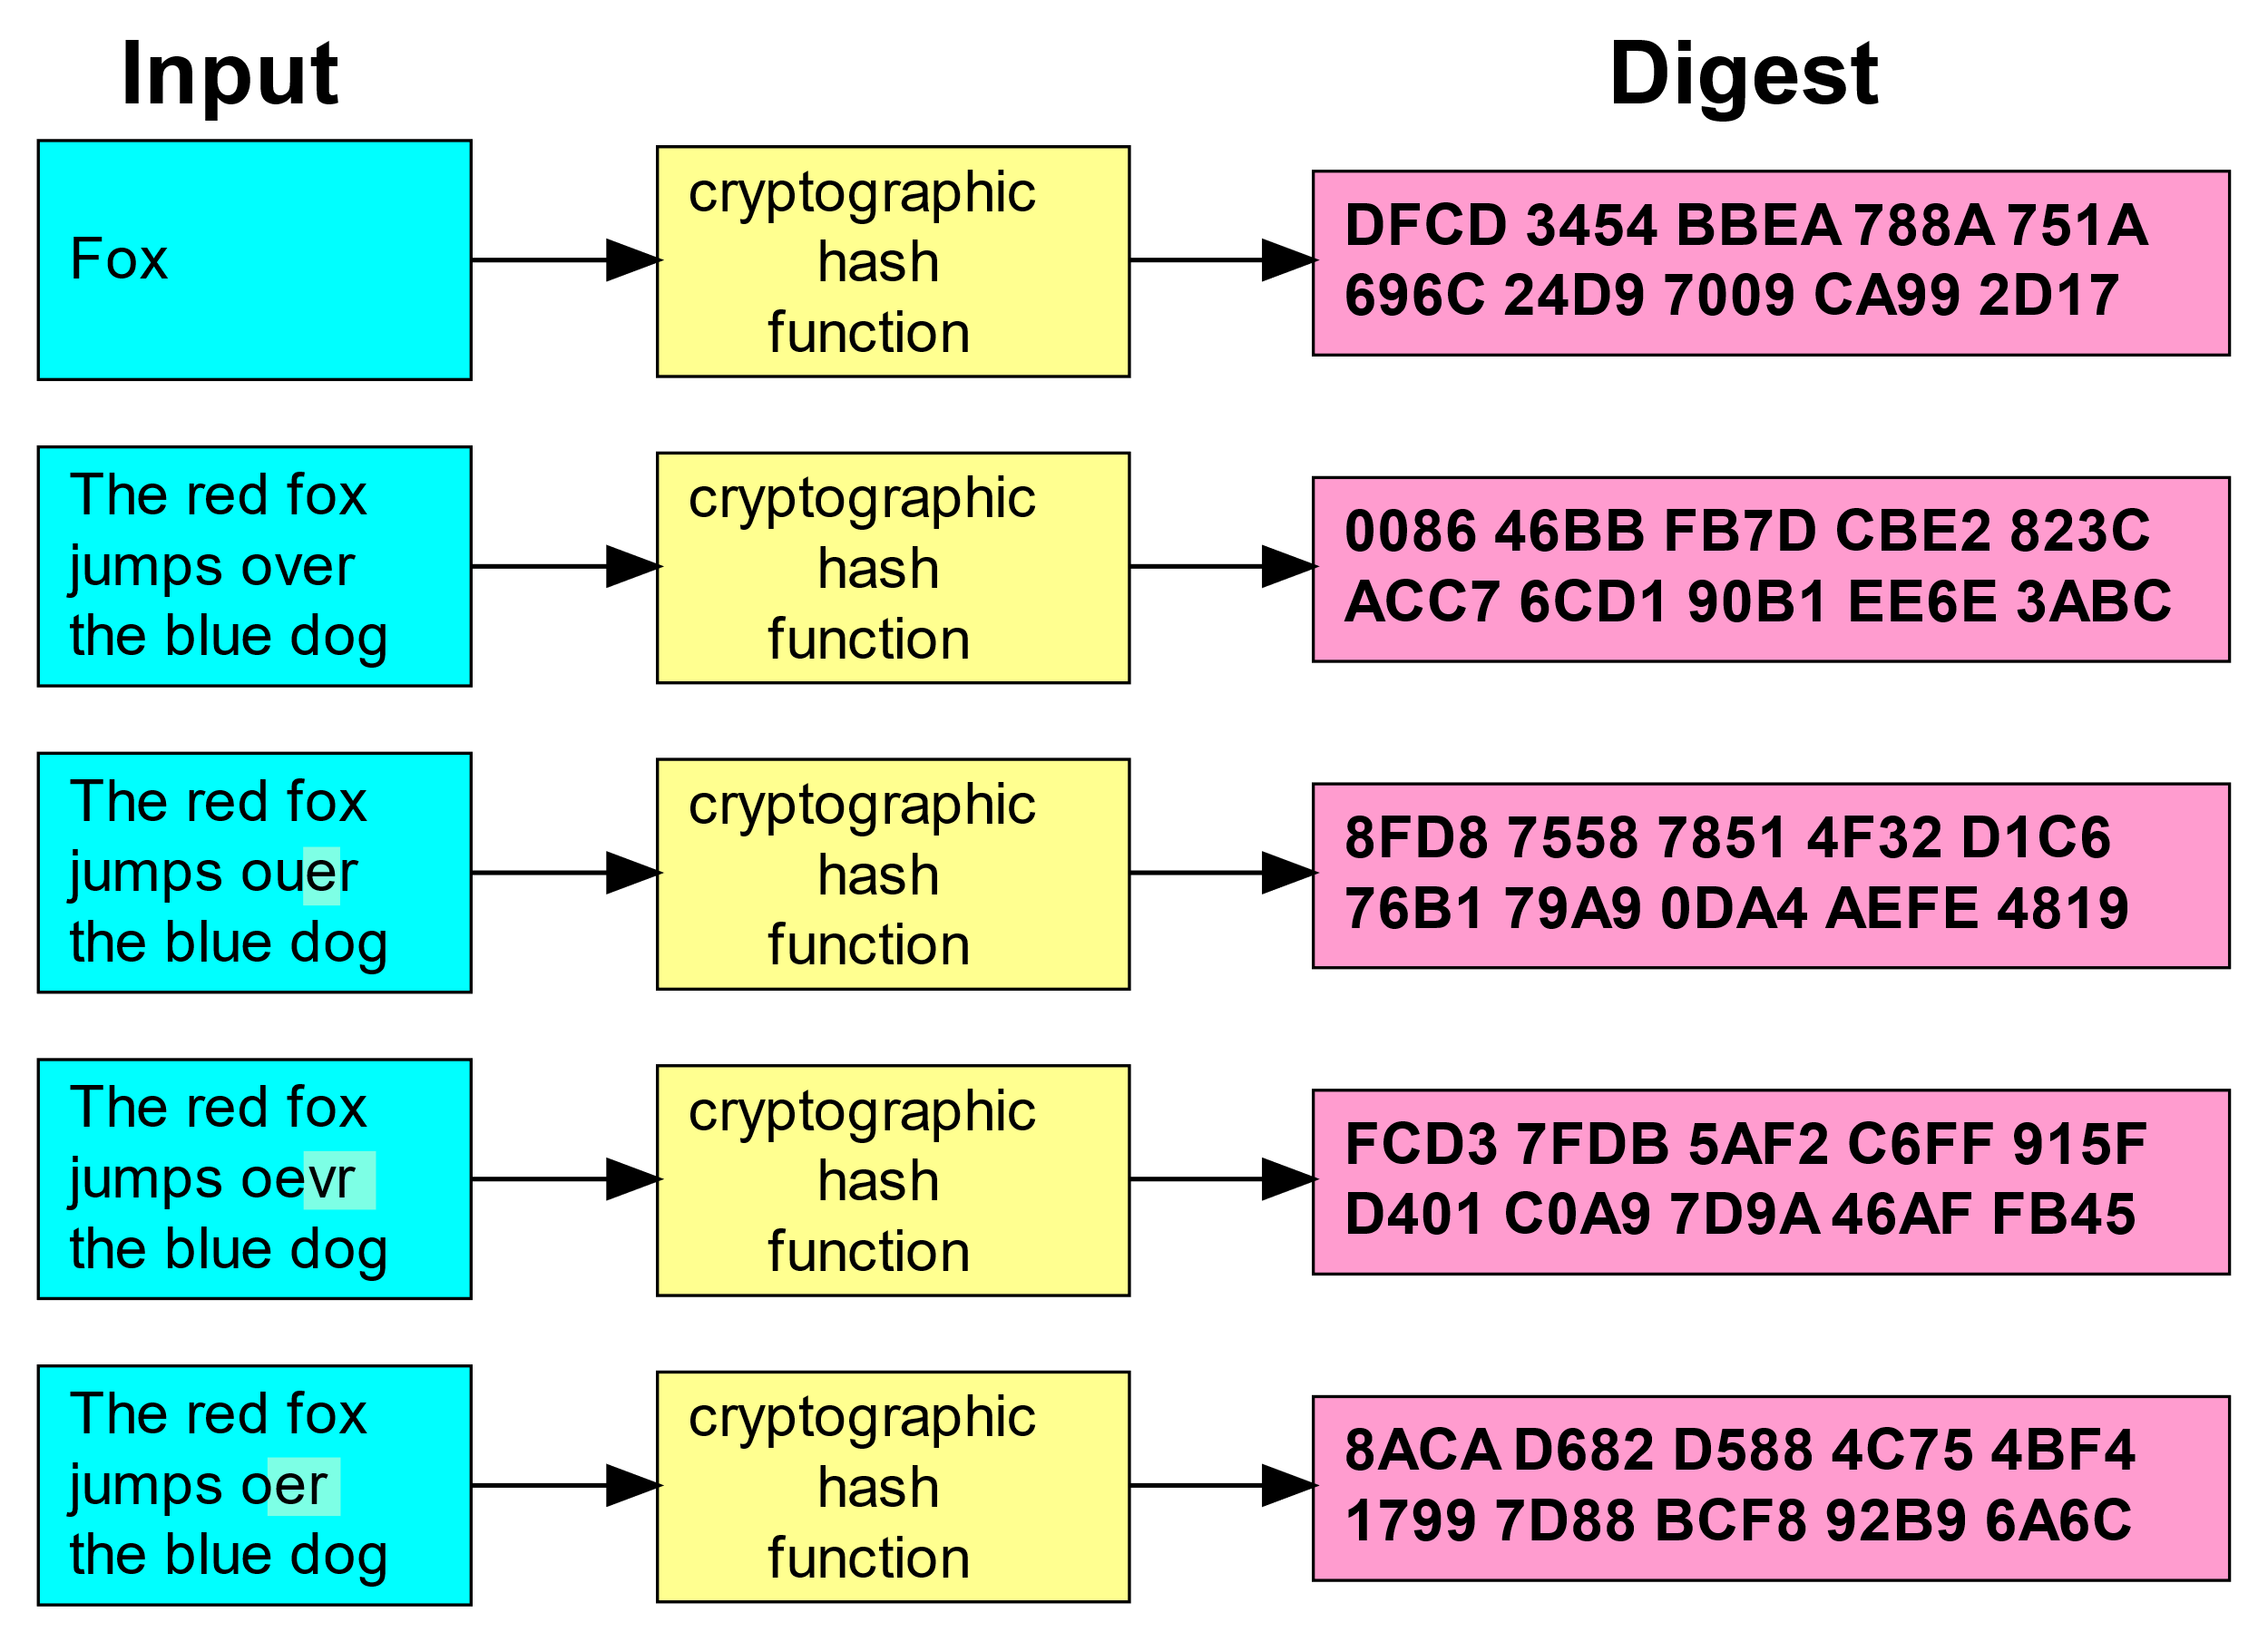
Cryptographic Hashes
Maps a message into a fixed-size digest (“hash”)
Deterministic
Collision-resistant
Non-reversible (one way), cannot compute message from hash
Examples: bcrypt, SHA-2
From https://en.wikipedia.org/wiki/File:Cryptographic_Hash_Function.svg
PLAIN TEXT
PLAIN TEXT
PLAIN TEXT
PLAIN TEXT
hash
==?
hash
hash

Slide 8
Digital Signatures
Originator encrypts hash with private key (“digital signature”)
Recipient decrypts hash with originator’s public key, and computes its own hash over the message
If the two hashes match, the message must have been signed by somebody in possession of the private key
PLAIN TEXT
PLAIN TEXT
PLAIN TEXT
PLAIN TEXT
signature
signature
hash
hash
==?
signature
hash

Slide 9
Typical Crypto Limitations
Implementing crypto algorithms is hard
Use approved libraries/products
Key material “weakens” (risk of eventual compromise increases) over time
Rotate keys on defined frequencies
Use recommended key lengths and algorithms
Protecting access to secret and private keys is hard
Re-key if somebody with access to a secret key leaves organization
Keep keys in as few locations as possible, defend them thoroughly
Don’t re-use the same key for different purposes or in different trust settings
Distributing public keys in a trustworthy manner is still hard
Use public key infrastructures!

Slide 10
Public Key Infrastructures
(or, how do I know that Alice’s public key that I grabbed from the web is the one that in fact matches Alice’s private key, and not Chuck’s, who is pretending to be Alice?)

Slide 11
Remember the Man in the Middle?
We want to distribute public keys freely, over networks
But is Alice in fact the one that possesses the private key to the public key that has her name on it?
Can I trust that digital signatures signed with the corresponding private key are in fact Alice’s signatures, and not somebody who’s pretending to be her?
Can messages I encrypt with this key only be decrypted by her?
PLAIN TEXT
PLAIN TEXT
A
C
A
C
A
A
C
C

Slide 12
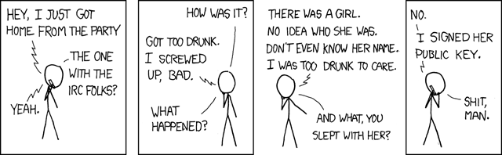
Attesting to a distributed key’s authenticity
https://imgs.xkcd.com/comics/responsible_behavior.png
Crowd-sourced web of trust (e.g., PGP)
Users attest to the authenticity of public keys by signing each other’s public keys (after having established that they have the same key in front of them)
Key Signing Party, anyone?
Trusted Third Parties
Certificate authorities establish a hierarchical chain of trust into public keys
All users trust the same CA, thus any public key signed by the CA is extended trust (without the need for a secure channel to obtain individual public keys)

Slide 13



Certificates!
CA
CA
Cert Signing Request
Name: Alice
Address: alice@foo.bar
Public key:
Certificate Authority
CA
CERTIFICATE
Expiration: …
Name: Alice
Address: …
Public key:
A
A signature
A
A
CA signature
PLAIN
TEXT
CIPHER TEXT
A
PLAIN TEXT
A
A
A

Slide 14


Transport Layer Security – crypto (simplified)
1: Client requests server certificate, validates it against CA cert
CERTIFICATE
Expiration: …
Name: Company A
Address: …
Public key:
A
CA signature
2: Client generates symmetric session key*
CERTIFICATE
Expiration: …
Name: Company A
Address: …
Public key:
A
A
CA signature
A
A
3: Client & server exchange traffic encrypted with the session key
ENCRYPTED PAYLOAD
(e.g., HTML)
*This is a much simplified view of how key generation with RSA works. Authentication of the server with RSA is implicit. DH/ECDH works differently.

Slide 15
Lifecycle of a server certificate
Public/private keypair management
Certificate request
Certificate issuance
Certificate use and revocation
Certificate consumption by clients

Slide 16
(1) Managing server public/private keys
Private keys should never leave the server (need to keep confidential)
Use Certificate Signing Requests instead of letting the CA generate the server’s public/private key pair
Do not share private keys across trust domains / between different services (lest compromise of the weakest link will compromise them all)
Beware of aging keys
Limit validity of certificates to an appropriate number of days or years
Generate new keys when “renewing” a cert instead of getting a new cert for the same old key
Consider new keys & certs if an operator with access leaves the organization
Self-signed certificates

Slide 17
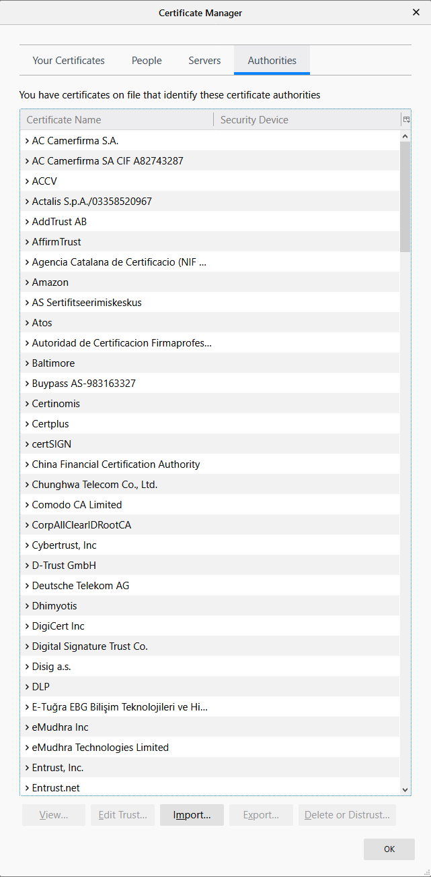
(2) Requesting a certificate
Prefer FQDN subject names over wildcards
Wild cards encourage proliferation of the same keys across different services / trust domains
Consider multiple Subject Alternative Names instead
Choose your CA wisely
Consider reputation of different CAs, even though browsers might trust them all
Consider validation and support needs (e.g., Let’s Encrypt – domain validation only)
Identity Verification
Registration Authorities – (in-person) offices of the CA for high-trust situations (e.g., validating somebody’s passport in person - not common in TLS server scenarios
Domain Validation – does the requesting organization control the domain that the cert is for?
Organization Validation – can the requesting organization prove its name/DBA/address as listed in the CSR?
Extended Validation – subject name matches organization’s incorporation doc
Certificate Signing Request (CSR) – standardized format to request a certificate
Does not include the user’s|server’s private key, but is signed by its private key to demonstrate possession of it

Slide 18
(3) Issuing a certificate
Do not use self-signed certs
Teaching users to click through warnings in their browsers desensitizes them against actual threats
Internal CAs for internal services are OK *if* they are managed properly
Mitigate risk of CA compromise
The root CA should be highly protected, offline, and only used to issue certs to certificate-issuing CAs lower down in the hierarchy
Consider using different cert-issuing CAs for different cert purposes / environments
Automation is OK…
...if cert requests are properly authenticated & authorized

Slide 19
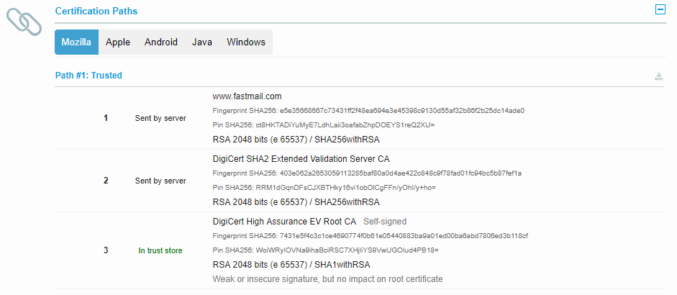
(4) Hosting and revoking certificates
Serve certificate chains with your certificate
Clients may break if intermediate certs are not served by your server, since they may only have the root CA certs in their trust stores
Monitor for certificate expiration
Revoke certificates for compromised or retired keys

Slide 20
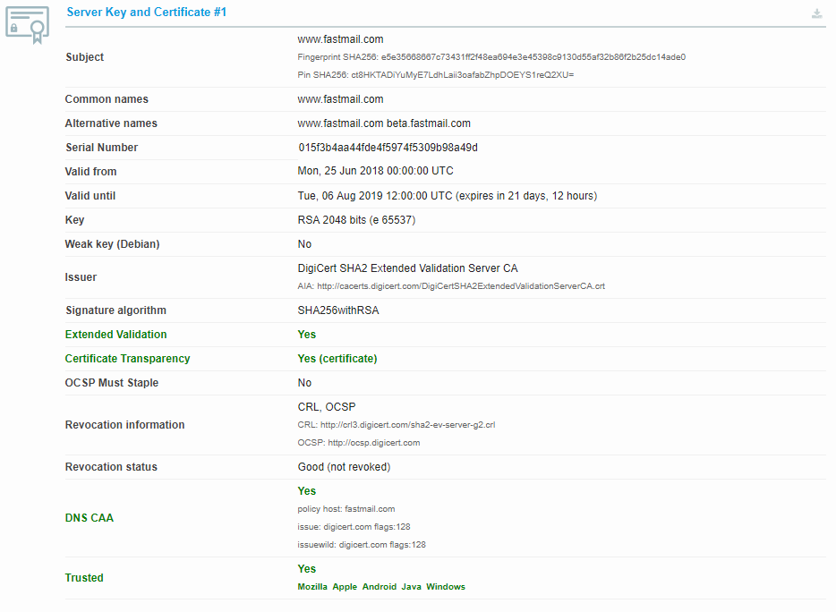
Certificates – the devil is in the details
Expiration Date
Purpose (domain validation, cert issuer)
Subject Alternative Names
Wildcard Certs vs. FQDN
Key Usage

Slide 21
Other uses of certificates & trust chains
Code signing
Windows updates
Europe: electronic signatures
Device authentication
User authentication
S/MIME
DNSSEC
PGP Web of Trust

Slide 22
Using certificates for authentication
Authentication factors: what you have; what you know; what you are
Certs (i.e., private keys!) are “what you know”
Same issue as passwords – can be cloned onto multiple devices, picked up by malware, …
Can be used to implement “what you have” if protected from cloning
E.g., on a smart card, HSM, secure enclave
Do certs authenticate users or devices?
Certs don’t authenticate anything, it’s the private key that corresponds to the public key in the cert that does the authentication
Arguably, the CA’s digital signature on the certificate provides for authenticity of the certificate’s content
Do keys (SSH keys, keys related to device certs, …) authenticate users or devices?
It depends – on usage, protection of the keys, context, …

Slide 23
SSL/TLS – Configuration Gotchas

Slide 24
Transport Layer Security – crypto (simplified)
1: Client requests server certificate, validates it against CA cert
CERTIFICATE
Expiration: …
Name: Company A
Address: …
Public key:
A
CA signature
2: Client generates symmetric session key*
CERTIFICATE
Expiration: …
Name: Company A
Address: …
Public key:
A
A
CA signature
3: Client & server exchange traffic encrypted with the session key
ENCRYPTED PAYLOAD
(e.g., HTML)
*This is a much simplified view of how key generation with RSA works. Authentication of the server with RSA is implicit. DH/ECDH works differently.

Slide 25
Versions
SSL is outdated and insecure
v2 – 1994 (Netscape Navigator 1.1 ☺)
v3 – 1995
TLS
1.0 – 1999 (RFC 2246), similar to SSLv3
1.1 – 2006, uses MD5 and SHA-1 (on it’s way out)
1.2 – 2008
1.3 – 2018

Slide 26

Cipher Suites
Determine the mix and match of crypto algorithms a client and server can agree on for:
Authentication
Key exchange
Encryption algorithm & key sizes
Etc.
Disable weak cipher suites
Prefer them in order of strength

Slide 27
Other Tidbits
Perfect Forward Secrecy
Session keys don’t depend on protection by the server’s private key
A result of using DH/ECDH (instead of RSA) for key agreement
If RSA is not supported by a web server, MITM traffic inspection will break ;-)
Various other, security-relevant configuration settings. For example:
Prevent protocol version downgrade attacks (TLS_FALLBACK_SCSV)
Reject insecure renegotiation (support the Renegotiation Indication extension, RFC 5746)
Tell clients to always use TLS (Strict Transport Security (HSTS))
Only use the TLS NULL compression method
Support OCSP stapling (RFC 6066)
Support session resumption

Slide 28
Potential Client Issues
Mismatch of supported protocol versions
Mismatch of supported ciphersuites
Certificate Pinning
Will interfere with MITM attempts to de- and re-encrypt traffic (e.g., for inspection)

Slide 29
Fun Tools
Dealing with certs
OpenSSL
Checking TLS configs
sslyze
www.ssllabs.com
observatory.mozilla.org
References
https://www.ssllabs.com/projects/documentation/

